Slide 1
GROCERY DELIVERY APPLICATION
Kaviya S - EBEON1222714256
Priyadharshini C - EBEON1222705676
Aarthy S - EBEON1222708290
Ranjithapriya T - EBEON1222722728
Guided by
A.Varadharajan

Slide 2
Abstract
An online Grocery store permits a customer to submit online orders for items and/or services from a store that serves online customers.
The online store system provides an online display of all the items they want to sell This web based application helps customers to choose their daily needs and products to their shopping cart.
Customers provide their complete detail of address and contact and they get their chosen products in their home

Slide 3
Introduction
A grocery shopping is an android application where users can purchase and order groceries online. The system is developed with a user-friendly and attractive GUI.
It delivers a wide range of groceries available online. Users have to first login into the system to view the groceries and add them into their cart.
They can then order it by making a secure online payment via CREDIT CARD. The system functionality of products and orders is stored on server side in a web service

Slide 4
Objective
Provide customers with a convenient and efficient way to purchase groceries online and have them delivered to their doorstep. The application typically allows customers to browse and purchase products from a wide selection of groceries, including fresh produce, packaged goods, and household items, among others.

Slide 5
Implementation
Software requirements:
Operating system: Window 10 or above.
Web browser: Google chrome, Microsoft edge.
Server: Tomcat platform
Front end: Html, Css, Angular, Js.
Back end: Spring boot, java, Hibernate, Mysql.
Hardware requirements:
60 MB of free hard-drive space
128 MB of RAM

Slide 6
Modules
Admin portal
Customer portal
Customer support
Delivery Portal

Slide 7
Delivery portal
SMS Process
Gps tracking

Slide 8
SMS process
SMS (Short Message Service) sending is a method of sending short text messages between mobile devices. In the context of a delivery application, SMS sending is used to send notifications to customers about the status of their delivery, such as when the delivery is dispatched, in transit, or has been delivered. SMS notifications can be sent automatically through the delivery application or manually by a customer service representative. SMS notifications can help improve customer satisfaction and reduce the number of customer inquiries about delivery status.

Slide 9
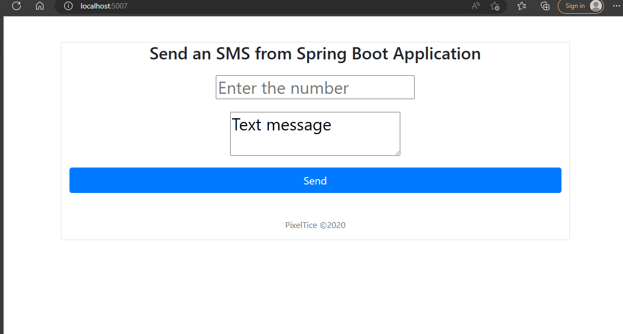

Slide 10
GPS Tracking
GPS tracking is the surveillance of location through use of the Global Positioning System (GPS ) to track the location of an entity or object remotely. The technology can pinpoint longitude, latitude, ground speed, and course direction of the target.

Slide 11
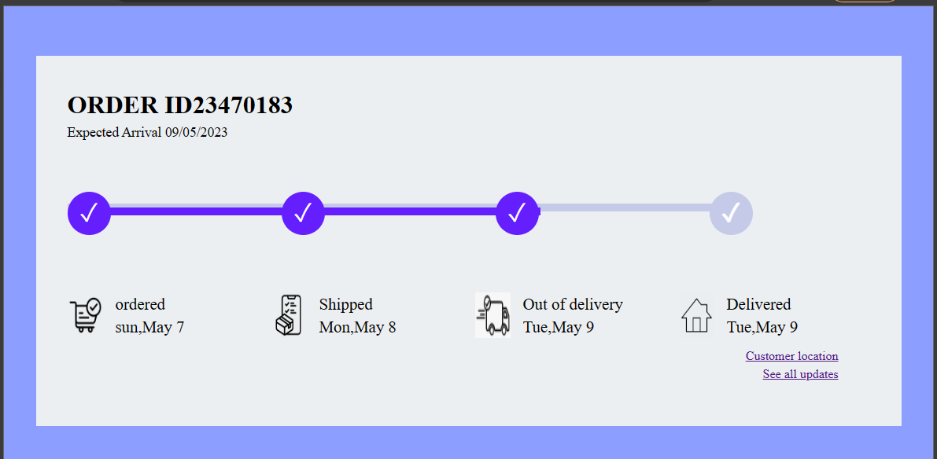

Slide 12
Goals
SMS Sending:
To provide timely and accurate updates to customers regarding the status of their deliveries. SMS messages can be used to notify customers when their order has been received, when it's out for delivery, and when it has been delivered. These notifications help to improve the customer experience by keeping them informed throughout the delivery process, reducing anxiety and increasing satisfaction. This proactive communication helps to build trust with customers and can lead to increased loyalty and repeat business.
GPS Tracking:
To provide real-time information about the location of delivery vehicles, packages, and their estimated delivery times. This technology allows companies to optimize their delivery processes, reduce delivery times, and improve customer satisfaction.

Slide 13
Flow chart
Start your order
Choose your
location
Show available grocery
shops
hoose
a
grocery shops near
C
by
you
Is open?
No
Yes
Choo
se your items
I
U
s
the
add
new cart
se
cart
card
listed?
No No
es
Yes
Y
S
e
lect
th
pay
e cart
SMS Sending
rder
Tracking
our
O
confirmed
Y
order was
delivered

Slide 14
Features
SMS Sending:
Order confirmation
Delivery updates
Delivery feedback
Promotions and offers
GPS Tracking:
Real-time tracking
Delivery route optimization
Faster deliveries
Enhanced security

Slide 15
Conclusion
Online grocery service meet a number of consumer needs including providing products for niche markets or helping the time starved consumer shop for the routine weekly groceries.
Handicapped and aged can participate in the shopping experience.

